Slide 1

Budget And Sales Analysis
By:- Harsh Saini

Slide 2

INTRODUCTION
In this presentation, we will explore a comprehensive analysis of budget and sales. Our goal is to uncover the factors that drive product performance. Join us as we delve into the data that shapes our understanding of market dynamics.

Slide 3

UNDERSTANDING BUDGET ALLOCATION
Active budget allocation is crucial for maximizing product performance. We will analyze how funds are distributed across various departments and their impact on overall sales and proﬁt margins. This understanding helps in making informed ﬁnancial decisions.

Slide 4

About The Data
To access the dataset: [https://shorturl.at/hUnay]
Budget Data:
Comprehensive Scope: The dataset covers various financial aspects, including allocated budgets across departments, tracking expenditure trends, and identifying cost-saving opportunities.
Granular Details: Detailed breakdowns by department and project allow for precise budget management and analysis of financial efficiency.
Customer Data:
Diverse Demographics: Captures detailed customer information, including age, gender, location, and purchasing behavior, helping to tailor marketing strategies.
Sales Performance:
Sales Trends: The data reveals seasonal and annual sales trends, assisting in inventory planning and promotional activities.
Profit Analysis:
Profit Margins: Detailed analysis of profit margins by product and region, identifying the most profitable areas of the business.

Slide 5
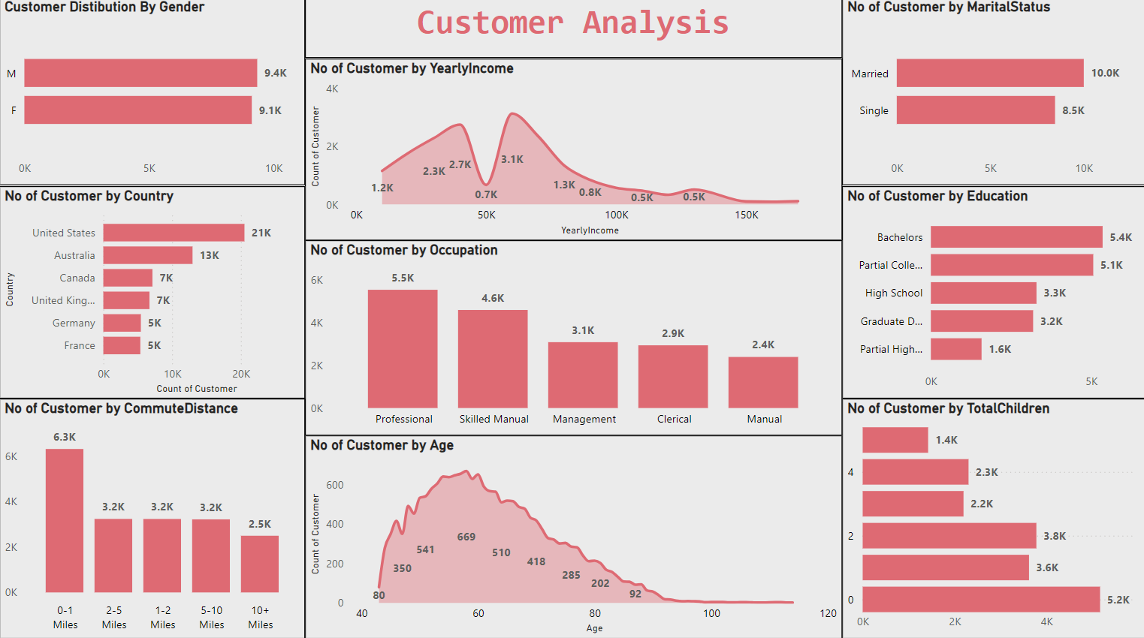

Slide 6
Customer Analysis & Insights
Gender Distribution: The customer base is almost evenly split between male (9.4K) and female (9.1K) customers, indicating balanced gender representation in the market.
Income Distribution: The majority of customers have a yearly income in the range of $30K to $80K, with peaks around $50K. This suggests that middle-income earners are the dominant customer group.
Marital Status: A larger portion of the customer base is married (10K), compared to single customers (8.5K). This could indicate that family-oriented services or products may resonate well with the customer base.
Country Representation: The majority of customers are from the United States (21K), followed by Australia (13K). This shows a significant concentration in these two countries, which might require region-specific marketing strategies.
Commute Distance: Most customers (6.3K) live within 0-1 miles of their workplace, indicating a preference for short commutes, which could be a factor in job satisfaction and retention.
Occupation: The largest occupational group among customers is professionals (5.5K), followed by skilled manual workers (4.6K). This may indicate a diverse skill set within the customer base, with a notable emphasis on professional services.
Age Distribution: The majority of customers are aged between 40 and 60, with a peak around 50 years old. This suggests that the customer base is predominantly middle-aged.
Education Level: Customers with a Bachelor’s degree (5.4K) and some college experience (5.1K) form the largest educational groups, highlighting a relatively well-educated customer base.

Slide 7
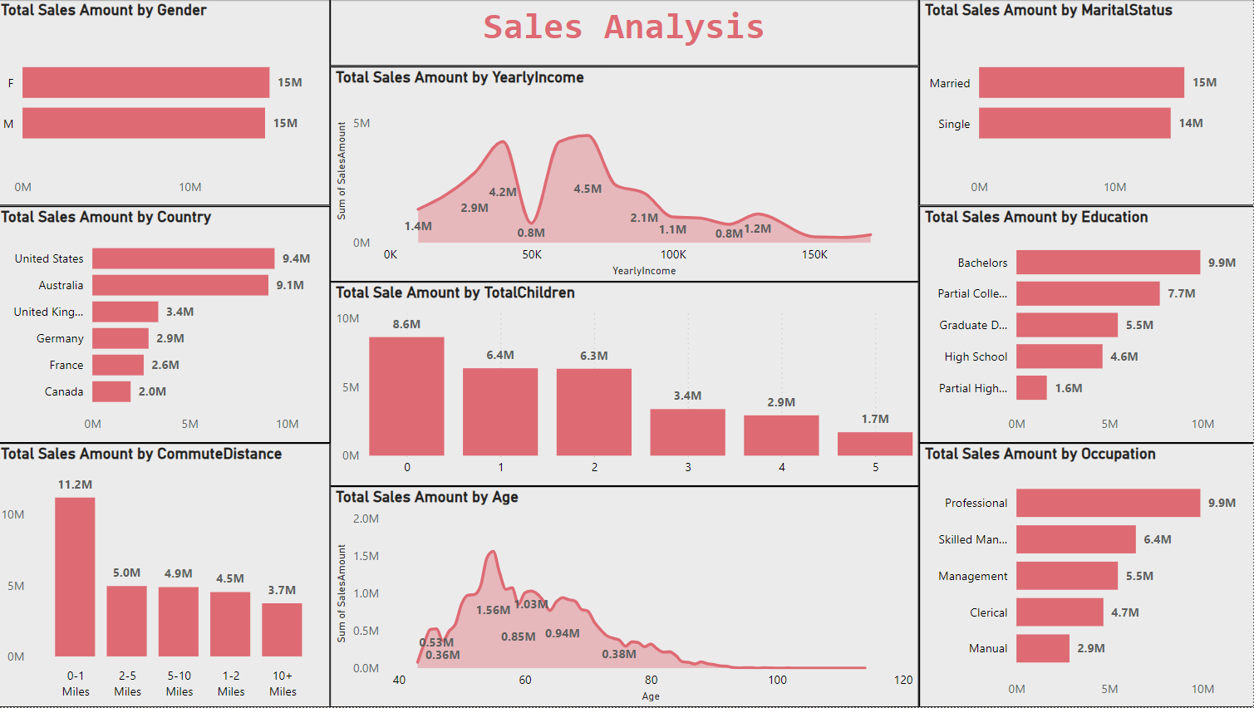

Slide 8
Sales Analysis & Insights
Income Impact on Sales: Customers earning between $30K and $80K contribute the highest sales amounts, with peaks at $50K ($4.5M) and $30K ($4.2M), suggesting that middle-income customers are the primary drivers of sales.
Marital Status Contribution: Married customers contribute slightly more to sales ($15M) compared to single customers ($14M), which could reflect higher spending power or household-related purchases.
Country Sales Distribution: The United States ($9.4M) and Australia ($9.1M) are the top contributors to sales, indicating these regions are key markets. Other significant contributors include the United Kingdom ($3.4M) and Germany ($2.9M).
Commute Distance Influence: Customers living within 0-1 miles of their workplace contribute the highest sales amount ($11.2M), which may indicate a correlation between proximity to work and spending capacity.
Sales by Number of Children: Customers with no children generate the highest sales ($8.6M), followed by those with one child ($6.4M) and two children ($6.3M), which may suggest that individuals or small families have more disposable income.
Educational Background and Sales: Customers with a Bachelor's degree are the largest contributors to sales ($9.9M), followed by those with partial college education ($7.7M), highlighting the importance of targeting educated consumers.
Sales by Age: The highest sales amounts come from customers aged between 40 and 60, with the peak sales at around 50 years old ($1.56M). This age group appears to have the highest purchasing power.

Slide 9
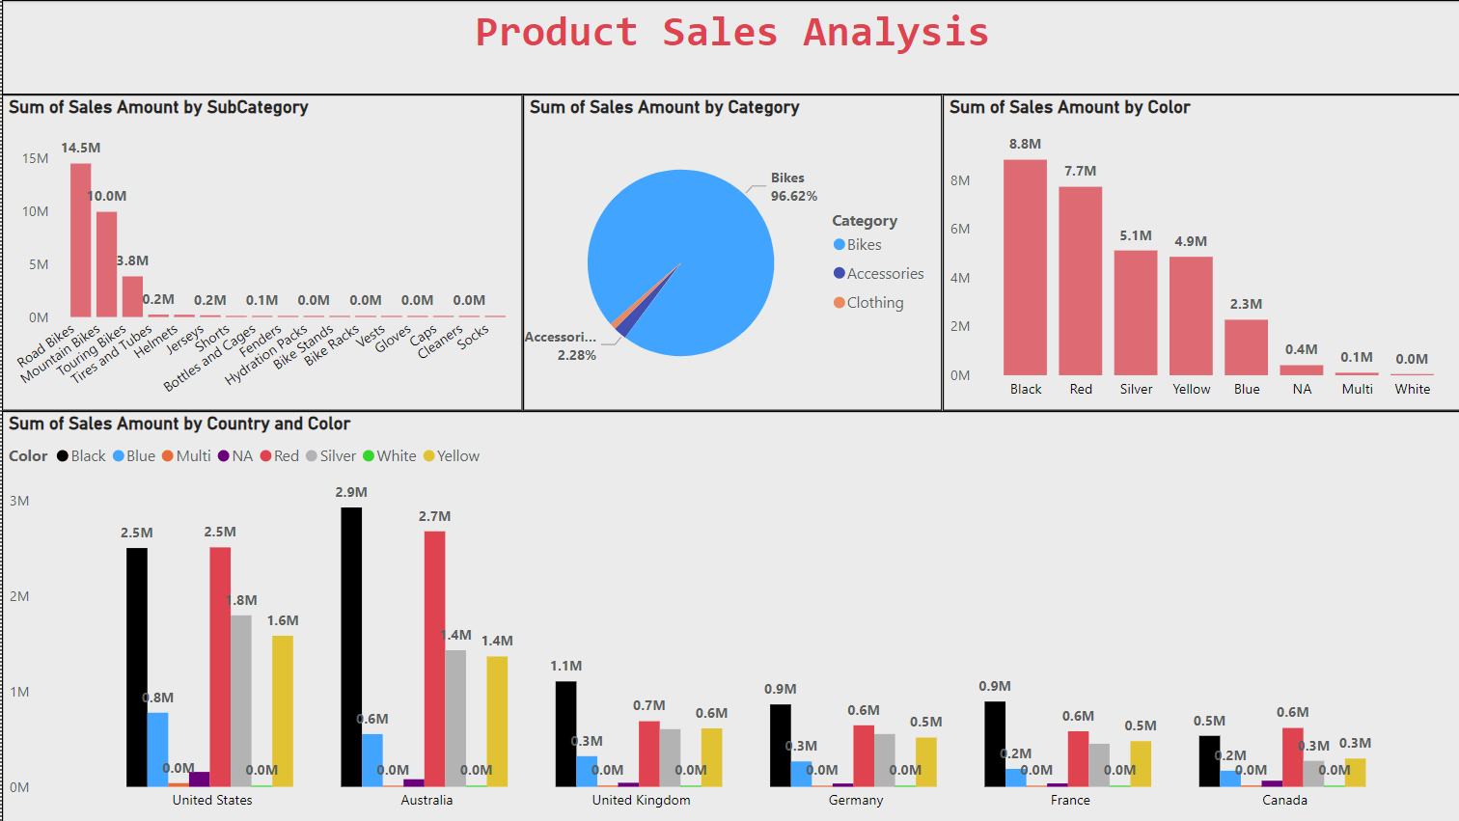

Slide 10
Product Sales Analysis & Insights
Bikes Dominate Sales: Bikes account for 96.62% of total sales, making them the most significant product category by a large margin.
Top Subcategory - Road Bikes: Road Bikes lead in sales with $14.5M, followed by Mountain Bikes at $10M, indicating a strong customer preference for these types.
Preferred Colors - Black and Red: Black ($8.8M) and Red ($7.7M) are the top-selling colors across all regions, reflecting a strong customer preference for these colors.
Country-Specific Color Trends: In the United States and Australia, Black and Red are the most popular colors, while in the United Kingdom, Black leads in sales.
Low Impact of Accessories and Clothing: Accessories and Clothing categories contribute minimally to overall sales, with Accessories making up only 2.28% of the total, suggesting limited customer interest.

Slide 11
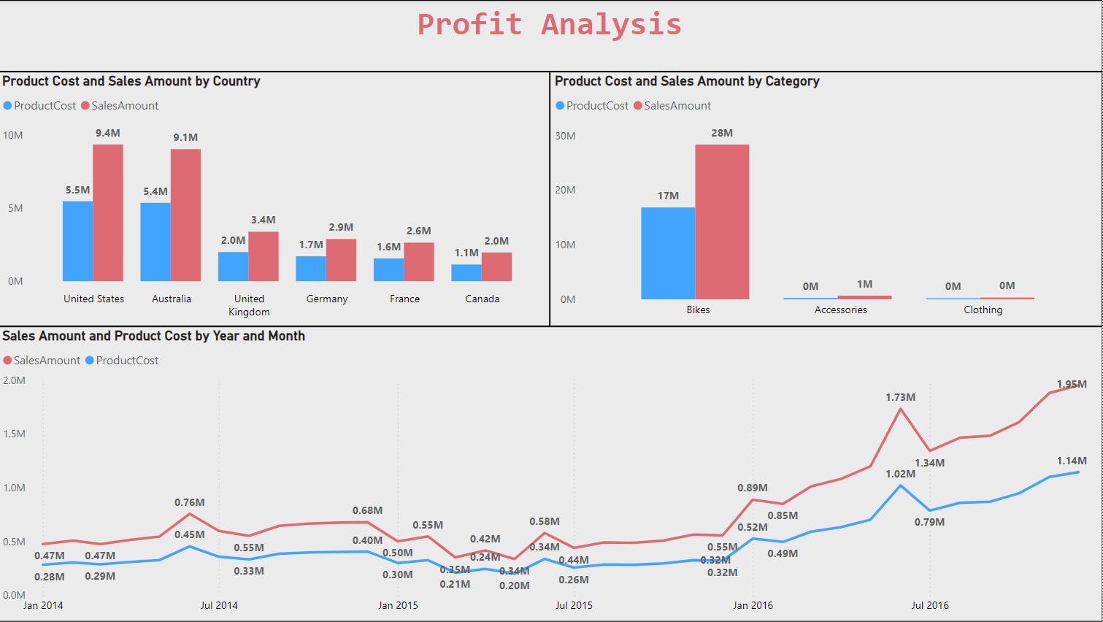

Slide 12
Profit Analysis & Insights
Overall Sales Growth: The line graph shows a general upward trend in sales revenue over the years, indicating overall growth in the business.
Country-Specific Performance: The bar chart comparing product cost and sales amount by country reveals that the United States and Australia have higher sales and lower costs compared to other regions, suggesting these markets may be more profitable.
Product Category Performance: The bar chart comparing product cost and sales amount by category indicates that Bikes have the highest sales and costs, while Clothing has the lowest. This suggests that Bikes might be the most profitable category, but it's important to consider other factors like profit margins.
Seasonal Sales Patterns: The line graph shows that sales tend to be higher in the latter half of the year (July) compared to the beginning (January). This could be due to factors like seasonal demand, marketing campaigns, or holiday sales.

Slide 13
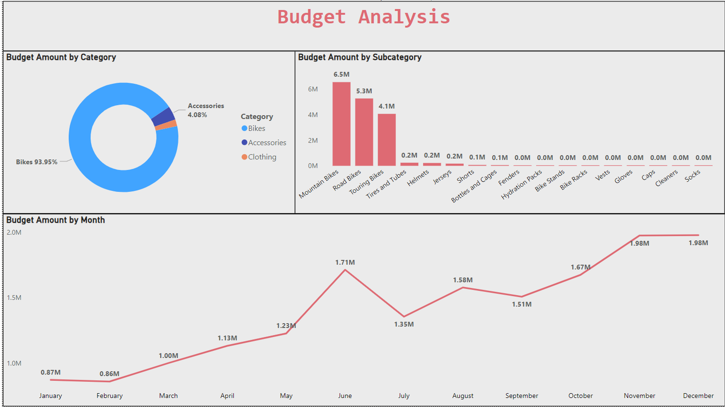

Slide 14
Budget Analysis & Insights
Dominant Category: Bikes are the primary category receiving the majority of the budget, accounting for 93.95% of the total. This suggests that the company prioritizes bikes as its core product or service.
Mountain Bikes: Within the Bikes category, Mountain Bikes have the highest budget allocation, indicating their potential importance or popularity.
Seasonal Fluctuations: The line graph shows variations in budget allocation across months. This could be due to factors like seasonal demand, production cycles, or marketing campaigns.
Highest Allocation: The month with the highest budget allocation appears to be December, potentially indicating increased spending for holiday promotions or year-end activities.

Slide 15
Recommendation
Expand the Bike Product Line:
Given that bikes, particularly Road and Mountain Bikes, dominate sales, consider expanding the product line with more options or specialized models. This could include new colors, features, or customization options.
Target Middle-Income Earners:
Since customers with yearly incomes between $30K and $80K contribute the most to sales, tailor marketing campaigns and product offerings to appeal to this demographic. Offering financing options or mid-range pricing could further attract these customers.
Enhance Online Presence in Key Markets:
Focus on strengthening online marketing and e-commerce platforms in the United States, Australia, and the United Kingdom, as these regions show the highest sales. Localized promotions and targeted ads could drive further growth.
Improve Product Availability and Customization:
Ensure that the most popular products and colors are readily available in all key markets. Consider offering customization options for colors or features, which can enhance customer satisfaction and attract more buyers.
Expand Accessory Line with High-Demand Items:
Although accessories currently represent a small portion of sales, identify high-demand items like helmets, gloves, or bike racks, and expand the accessory line with quality products that complement the bikes.
Enhance Customer Engagement and Feedback:
Implement a feedback system to regularly gather customer insights on product satisfaction and potential improvements.
Expand Market Reach:
Explore markets with high growth potential, such as regions with increasing demand for cycling or outdoor activities.
Foster Partnerships:
Partner with bike shops and retailers to expand distribution channels.

Slide 16
CONCLUSION
In conclusion, to boost sales and keep customers happy, we should focus on expanding our best-selling bike lines, targeting key customer groups, and offering more personalized options. By expanding our marketing and improving how we engage with customers, we can strengthen the loyalty and grow our business in the market.

Slide 17
Thanks!
Do you have any questions? harshsaini1324@email.com

